Slide 1
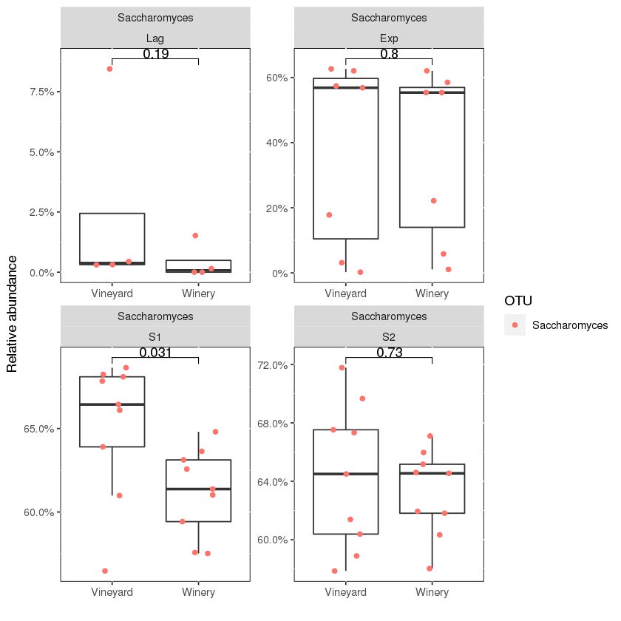
A
Lag
Exp
S1
S2
Saccharomyces
A) Shows the significant difference (p <0.05) of Saccharomyces at the S1 phase.
Lag = Lag phase – days 1-4; Exp = Exponential phase – days 5-11; S1 = Early stationary phase 1 – days 12 - 20; S2 = Late stationary phase 2 – day 21 - 28AP.

Slide 2
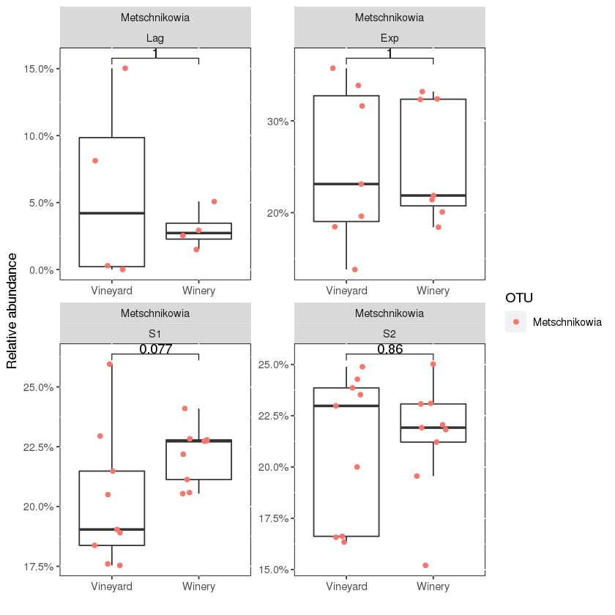
B
Lag
Exp
S1
S2
Metschnikowia
B) No significant difference (p >0.05) between Metschnikowia abundance across both systems.
Lag = Lag phase – days 1-4; Exp = Exponential phase – days 5-11; S1 = Early stationary phase 1 – days 12 - 20; S2 = Late stationary phase 2 – day 21 - 28AP.

Slide 3
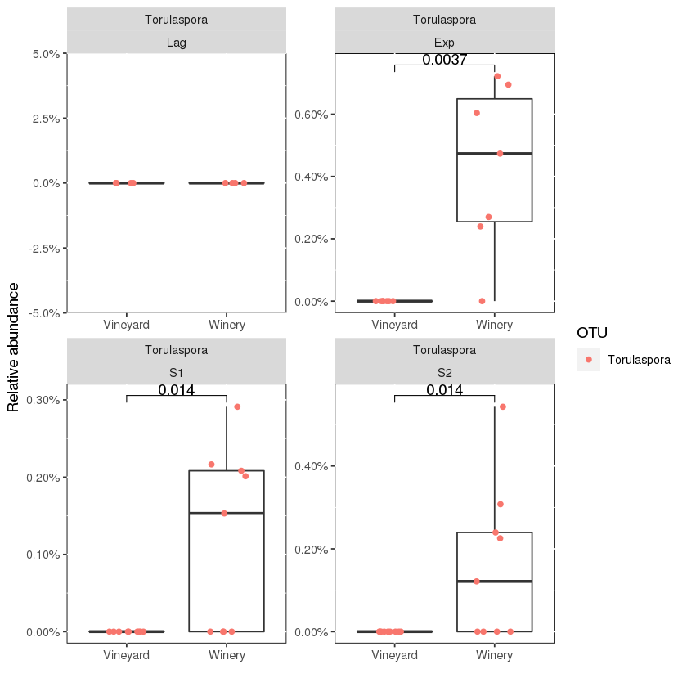
C
Lag
Exp
S1
S2
Torulaspora
C) Significant difference (p <0.05) of Torulaspora at the Exp, S1 and S2 phase.
Lag = Lag phase – days 1-4; Exp = Exponential phase – days 5-11; S1 = Early stationary phase 1 – days 12 - 20; S2 = Late stationary phase 2 – day 21 - 28AP.

Slide 4
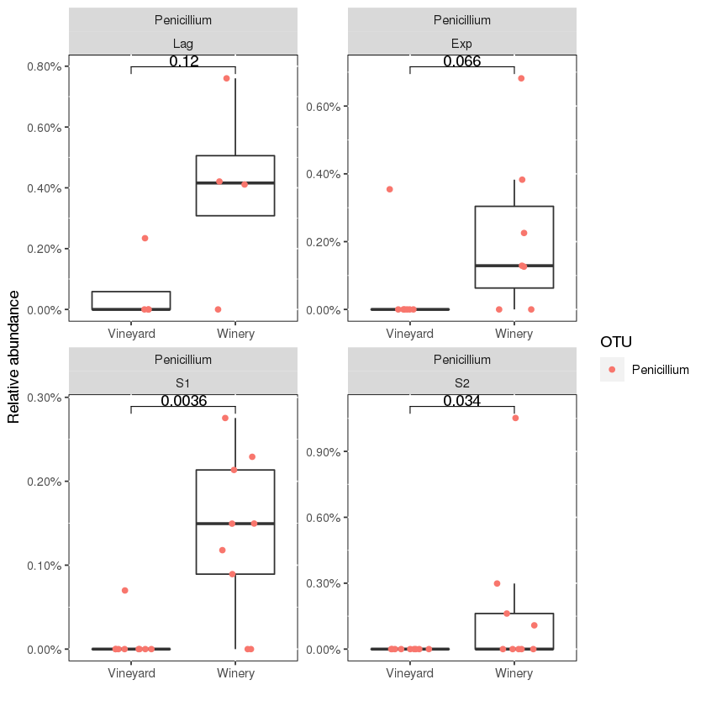
D
Lag
Exp
S1
S2
Penicillium
D) Shows the significant difference (p <0.05) of Penicillium at the S1 and S2 phase.
Lag = Lag phase – days 1-4; Exp = Exponential phase – days 5-11; S1 = Early stationary phase 1 – days 12 - 20; S2 = Late stationary phase 2 – day 21 - 28AP.

Slide 5
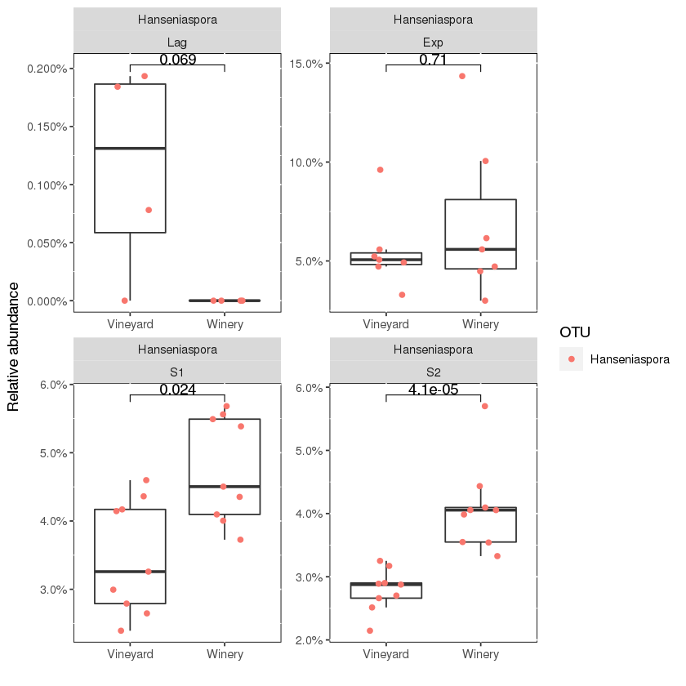
E
Lag
Exp
S1
S2
Hanseniaspora
E) Shows the significant difference (p <0.05) of Hanseniaspora at the S1 and S2 phase.
Lag = Lag phase – days 1-4; Exp = Exponential phase – days 5-11; S1 = Early stationary phase 1 – days 12 - 20; S2 = Late stationary phase 2 – day 21 - 28AP.

Slide 6
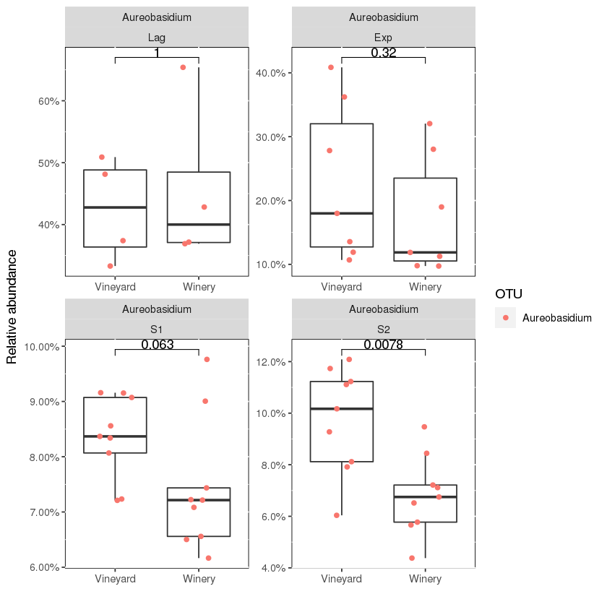
F
Lag
Exp
S1
S2
Aureobasidium
F) Shows the significant difference (p <0.05) of Aureobasidium at the S2 phase.
Lag = Lag phase – days 1-4; Exp = Exponential phase – days 5-11; S1 = Early stationary phase 1 – days 12 - 20; S2 = Late stationary phase 2 – day 21 - 28AP.

